Slide 1
DeFi Score
Assessing Risk in Permissionless Lending Protocols
DevCon
October 2019
Notes:
INTRO: Greethings, thanks to [organizer/host] [everyone]
POINT: I want to talk to about: defi, risk, & how we can help participants make better decisions
SEGWAY: [quick intro - who I am…]

Slide 2

Introduction
Full Stack Engineer @ConsenSys
Previously @RadarRelay
DeFi Nerd
@jack_clancy93
Notes:
INTRO: My Day job(s): Consensys, radar relay. Based out of NYC...
POINT: I’m excited about DeFi because
As a student I enjoyed finance and computer science
As a long time DeFi user I also get to see how much the industry has grown and matured over the last 2 years
SEGWAY:
...And when I think about the future of defi I get both excited and worried

Slide 3
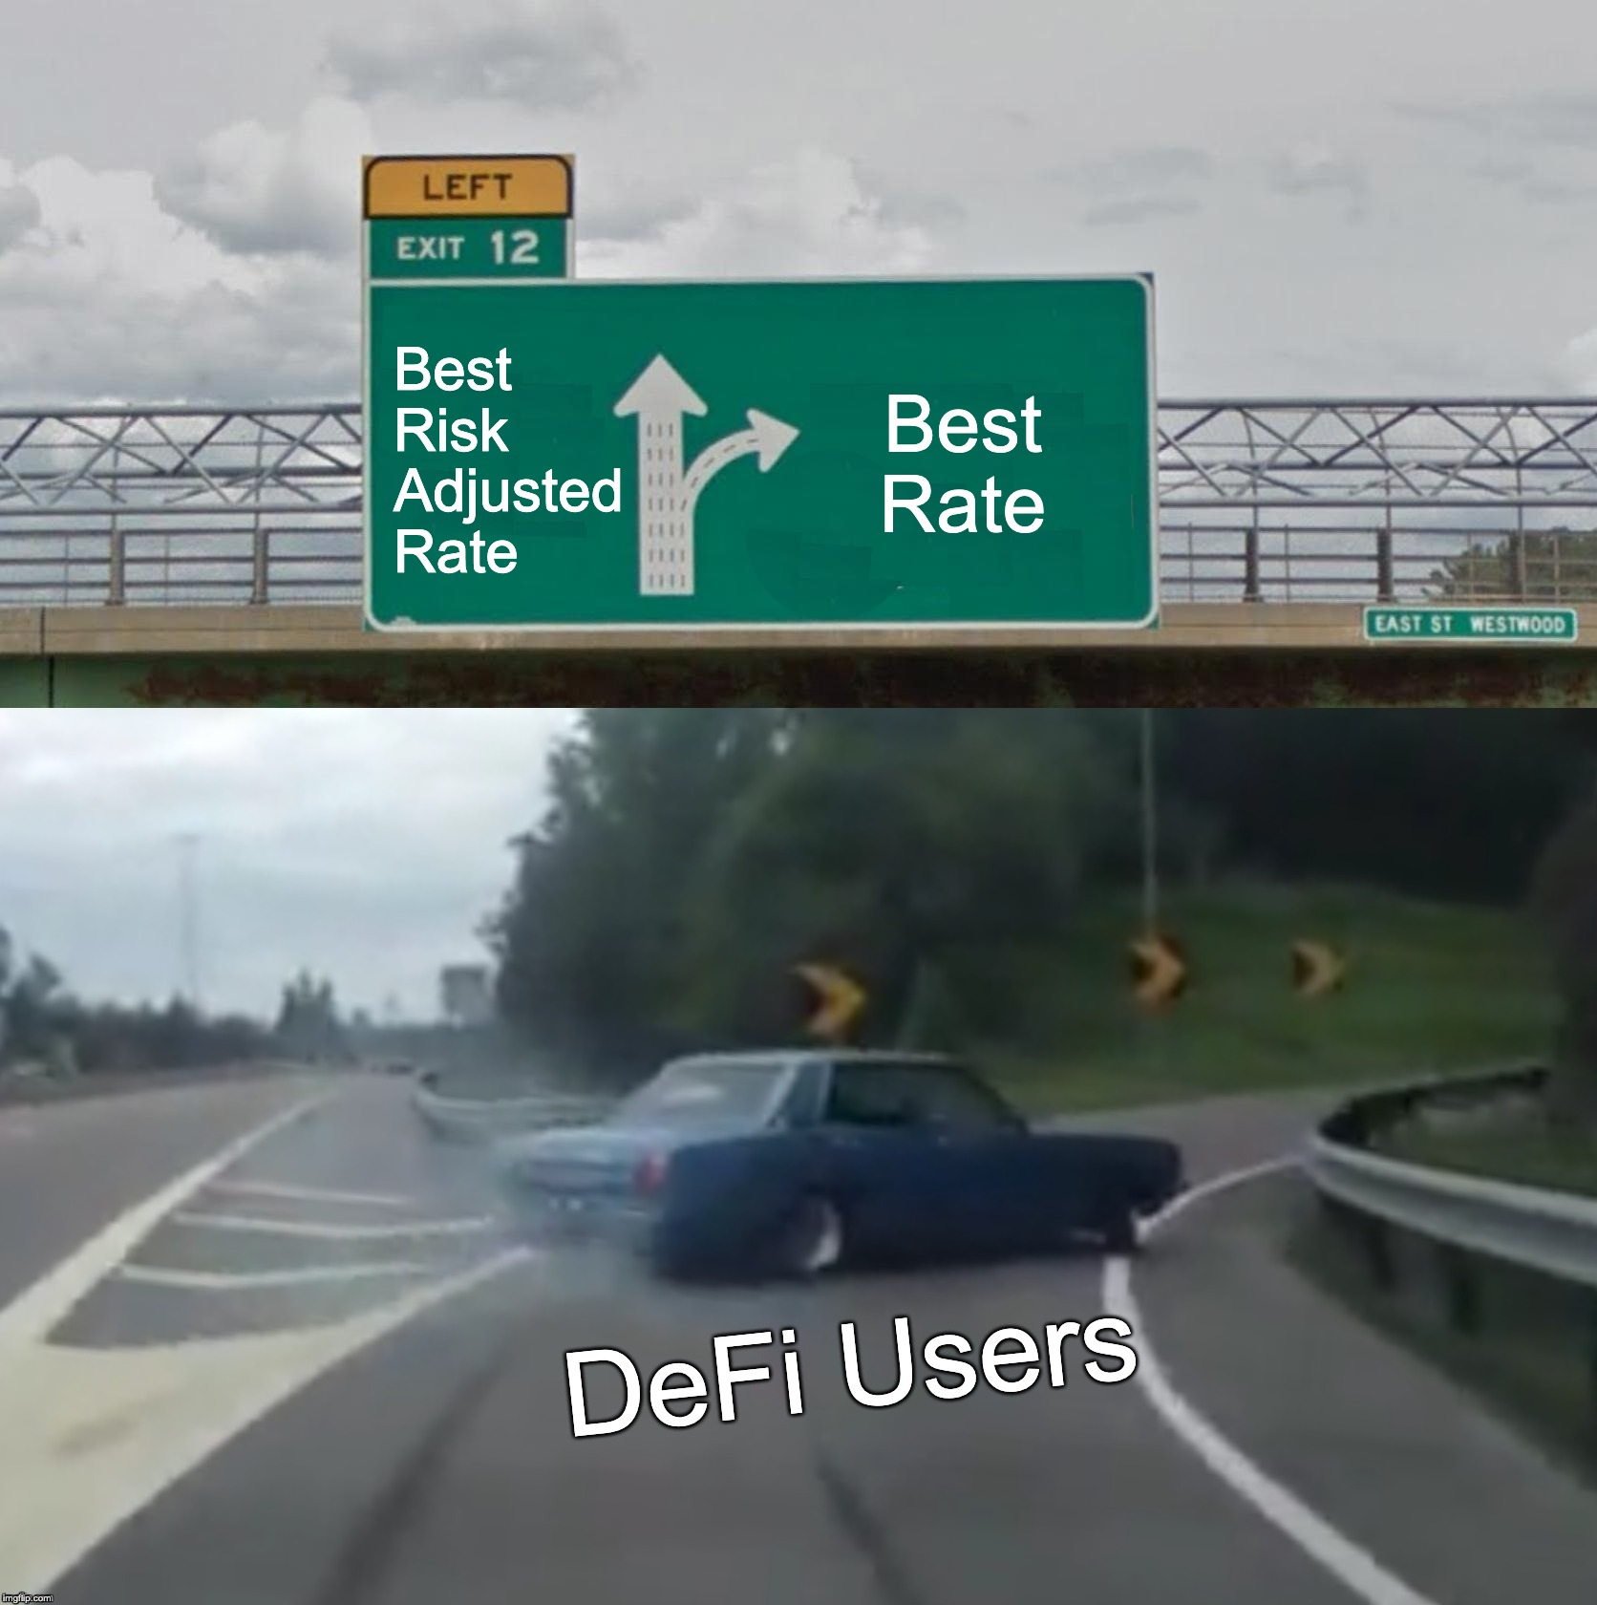
Motivation
Notes:
INTRO: There is no such thing as a free lunch
POINT: It seems like a lot of people are just chasing the highest rate of return, without any consideration of the risks or consequences
SEGWAY: As these products get more complex, users are going to be even more conflicted

Slide 4
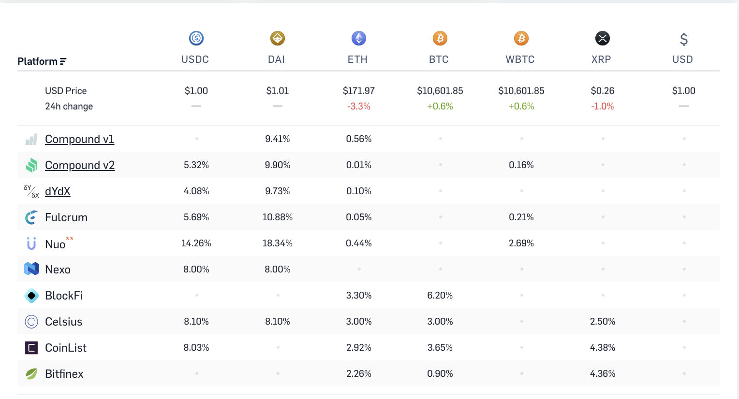
Motivation
All lending protocols are not created equal,
comparing rates is hard and has many pitfalls
Notes:
INTRO: The truth is different lending products have different approaches which results in different risk/reward profiles.
POINT The average person is not very good at making the optimal financial decision for themselves, too many pitfalls
SEGWAY: As DeFi grows, how do we ensure that users are encouraged to make optimal financial decisions?

Slide 5
Motivation
Empower DeFi users to make better financial decisions
Interest rates don’t tell the entire story, we need to provide users with tools to differentiate between yield (%) and risk-adjusted returns.
Notes:
INTRO: I couldn’t find a good solution to that question, So I set out to improve the way we think about, and more importantly, communicate risk to the defi public
POINT: Interest rates alone aren’t enough. Similar to how one wouldn’t treat at an AAA and a C rated bond’s interest rate as the same.
SEGWAY: So I decided to do a risk assessment and try to quantitatively assess risks affecting different products

Slide 6
DeFi Score
An open source methodology to quantify the technical and financial stability of a defi protocol.
Security & Openness
Liquidity & Collateralization
Notes:
INTRO: The DeFi Score is … “An open source, simple proxy for a platform’s trustworthiness that average users can easily understand”
POINT: DeFi platforms are complex and include new types of risks that differ from traditional financial markets, for example, code risk that is too difficult or unfamiliar for even the most advanced users to understand. To launch we’ll consider some of the largest and most easily quantifiable risks
SEGWAY: Remember intention of this score is to better educate users on the unique nuances of smart contract enabled financial markets. The model can and should grow over time.

Slide 7



Methodology
Code Risk: Security & Openness
Notes:
Quick POINT: So let’s dig into the methodology, starting with security & openness of smart contracts

Slide 8
Code Risk: Smart Contract Security
Smart Contract Bugs can cause REAL financial harm
Remember the DAO and Parity Multisig…..
How can we assess smart contract security?
Have the contracts been audited?
Have they been formally verified?
Is there an outstanding bug bounty program?
Notes:
[I think it can be assumed that the audience understands the importance of smart contracts -tm]
INTRO: “newsflash”
POINT:
Smart Contract Risk is very similar to Counterparty Risk
The security of smart contracts are extremely important when evaluating the risk of users losing funds that are stored in a smart contract when interacting with many DeFi platforms. As the ecosystem learned from events like the DAO hack and the Parity Multisig bugs, errors in smart contracts can result in significant financial harm.
While no smart contract can be guaranteed to be devoid of bugs, a thorough code audit and formal verification process from a reputable security firm helps uncover critical, high severity bugs that could result in financial harm to users. Bug bounty programs are another positive indicator that the development team takes security seriously by incentivizing independent security researchers to discover protocol bugs, ultimately allowing for a more widespread security review.
SEGWAY: Something else that is important to the risk of a smart contract based financial product is code openness…..

Slide 9
Code Risk: Smart Contract Openness
Don’t trust, verify
If a protocol is completely onchain & transparent it can be verified by auditors and the community
How can we assess smart contract openness?
Is the code open source?
Is the bytecode verified?
Notes:
INTRO: Smart contract code isn’t trustless unless the public can read it and verify it
POINT: Part of the promise of DeFi is that the functionality of smart contracts is completely on-chain, which means they are verifiable and transparent. Developers of DeFi platforms still have the ability to obscure their code in various ways, such as not verifying the bytecode and using off chain oracles processes. Security through obscurity offers weak security guarantees at best, and at worst results in delays in finding critical bugs. While bytecode decompilation is possible, it is a difficult and time-consuming process and makes it hard to follow the mantra of “don’t trust, verify”.
SEGWAY: Code risk is only one aspect of the risks one faces when investing in DeFi products

Slide 10
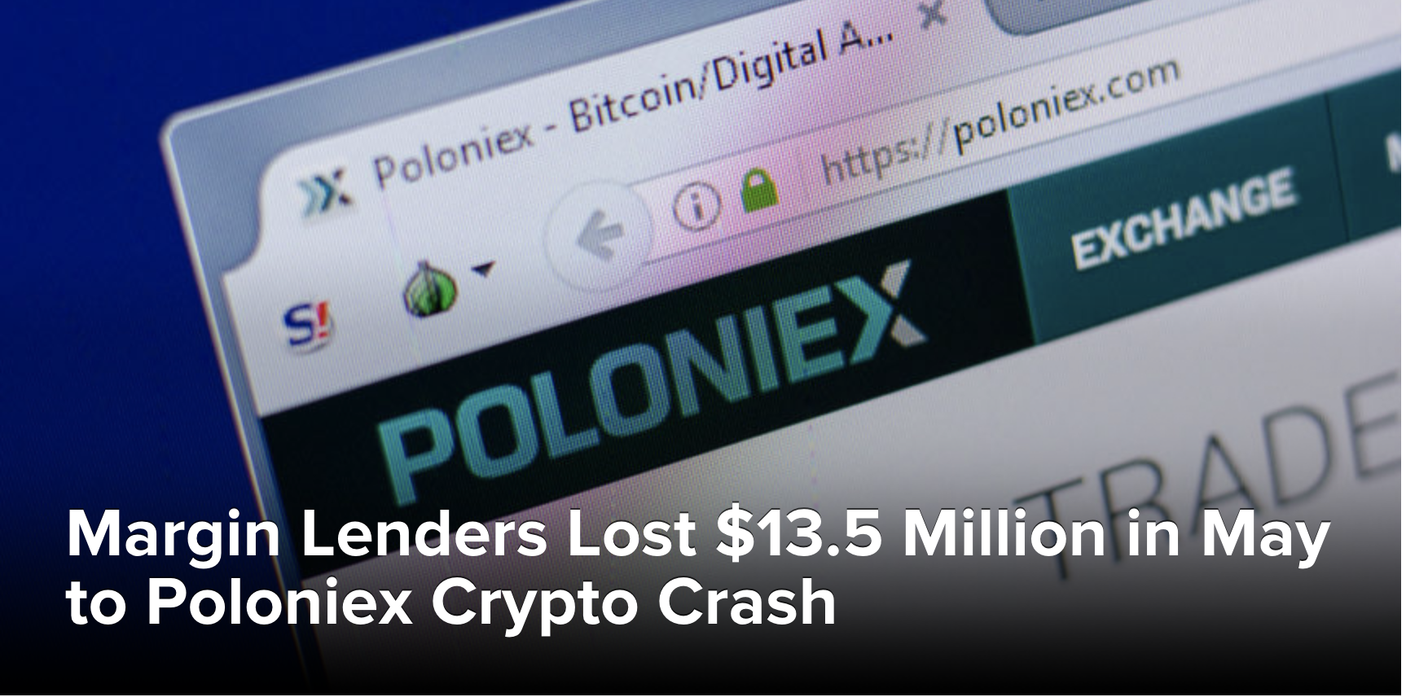
Methodology
Financial Risk: Collateral & Liquidity
Notes:
DeFi contains many of the same risks as legacy finance. While assessing smart contract risk is a novel type of risk assessment, there have been decades of prior work done to evaluate financial risk.
What complicates this is that smart contract based financial products enable a level of flexibility that has is hard to match in the legacy financial world.

Slide 11
Collateral Risk
Crypto makes for bad collateral
The makeup and liquidity of the underlying collateral determine the health of secured debt. Not all lending products are created equal.
How can we assess collateral risk?
Collateral ratios compared to other products
CVaR of collateral portfolios
Notes:
INTRO: Without a widely accepted approach to on-chain reputation or identity, the only method to avoid unwanted amounts of credit risk in DeFi money market platforms is to use over-collateralization.
POINT: While all of the current platforms use very conservative collateral factors, the highly volatile nature of crypto assets means that these high collateral factors may still be insufficient.
Poloinex recently has a situation like this play out. The CLAMS token was margin tradeable and crashed over 75% in a matter of 45 minutes. which led to a 1800 BTC socialized loss. Overcollateralization is by no means foolproof.
The makeup of collateral assets that back these DeFi platforms have a high level of variation, with some being made up of much more liquid, stable assets than others. For example, a platform may be primarily backed by ETH. While ETH is still a very volatile asset, it is relatively stable and liquid compared to an asset like LINK. These collateral makeup differences are an important factor when thinking about platform risk.
There are many different models to assess the risk of a portfolio of assets. One of the most common models is the VaR (Value at Risk) model. There are multiple different variations of the VaR model. This model currently uses the CVaR (Conditional Value at Risk) model, also known as the Expected Shortfall model. The methodology uses CVaR over VaR because CVaR better captures the probability and drawdown of more extreme scenarios. The above figure helps demonstrate this difference-- the CVAR (ES) model results in a larger potential drawdown. Due to the nascency and extreme volatility present in crypto assets, the methodology is more conservative.
SEGWAY: Liquidity and insolvency crises often go hand in hand. There are numerous historical examples of these types of crises...

Slide 12
Liquidity Risk
Incentivized liquidity does not mean guaranteed liquidity
Lenders takes on risk that they will not be able to withdraw their assets at will because they are currently lent out
How can we assess liquidity risk?
Trailing 30d liquidity compared to other products
Notes:
INTRO: Incentivized liquidity does not mean guaranteed liquidity.
POINT: A user takes on risk that they will not be able to withdraw their lent out assets on demand because all the assets are currently lent out. This happened with Compound when the InstaDapp bridge launched and they were forced to change the bounds of their interest rate model
SEGWAY: Financial and code risk are not the only types of risk a user of these products face….

Slide 13
Other Considerations
Notes:
These factors are harder to quantify, but have been included in the model because they are important

Slide 14
Insurance
The insurance pool isn’t very deep
Developed financial systems have deposit insurance (up to $250k in the US)
Some protocols dedicate some interest to an insurance pool, but still nowhere near large enough to cover solvency or liquidity crisis
There are promising developments in the smart contract insurance space like Nexus Mutual
Notes:
INTRO: Users do not have the same safeguards they have with deposit accounts. This is a usability issue that is a big barrier to adoption
POINT: Financial risk will be a critical part to making DeFi more mainstream. Products like Nexus Mutual are promising, but the insurance space is still wide open. Excited for more focus and innovations in this space over the coming years. Yield protocol with built in insurance anyone??
SEGWAY: We might also see traditional insurers enter the DeFi space under certain circumstances as it becomes more mature. However there is the big question of what regulators will do with these products….

Slide 15
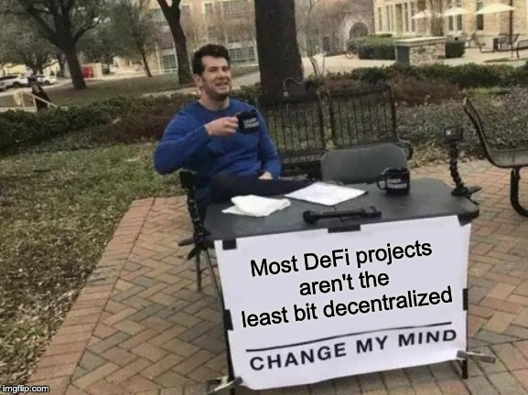
Regulatory Risk
Notes:
INTRO: Could the DeFi protocols you’re using survive a government shutdown order? If not, it’s not really DeFi.
POINT: That being said, there is nothing wrong with starting a centralized product and decentralizing more over time. This is how many current “DeFi” products are positioned. Keep in mind, a lot of these projects are privately funded and have no mandate to become decentralized, even if they are saying they will be. I have faith but it’s a risk worth being aware of.
SEGWAY: These are all of the current aspects of the model. Let’s dig into some real life scores and how we formulate them….

Slide 16
Closing Thoughts
Notes:
Closing thoughts before we open up to questions

Slide 17
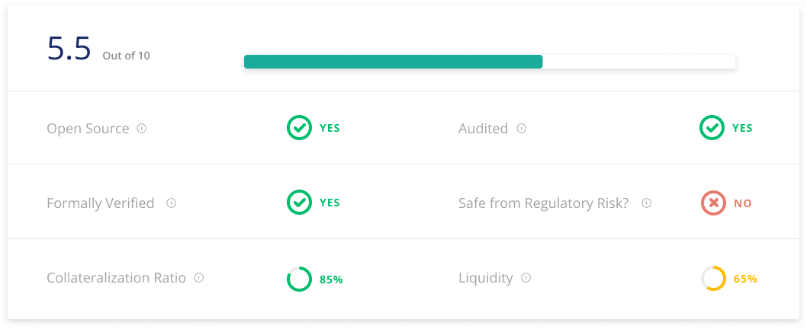
Example Implementation
Notes:
INTRO: Here is what a sample visualization of a score could look like
POINT: The underlying methodology is fairly complex, but that doesn’t mean it can be simple for a user to understand.
SEGWAY: Even with a robust and validated methodology, this score can’t help the industry if it isn’t easily understood by the average DeFi user, who will likely be less and less informed as the ecosystem grows

Slide 18
Conclusions
The future of DeFi is extremely exciting and one day it will fully deserve the name DeFi
This is a nascent space with lots of risk - We should attempt to quantify, communicate and mitigate as much as possible
Risk people should be excited about how transparent and auditable these systems are
Notes:
INTRO: The future of DeFi is really exciting!!
POINT: If you’re not involved yet, you’re missing out. Parallel financial system is reach escape velocity. Synthetic assets and on chain insurance are going to allow us to hedge a lot of these risks. But we need to be aware of these risks before we can hedge them. Let’s be responsible when creating this new system.
SEGWAY: If you want to help shape the future of risk management, get involved!

